Slide 1
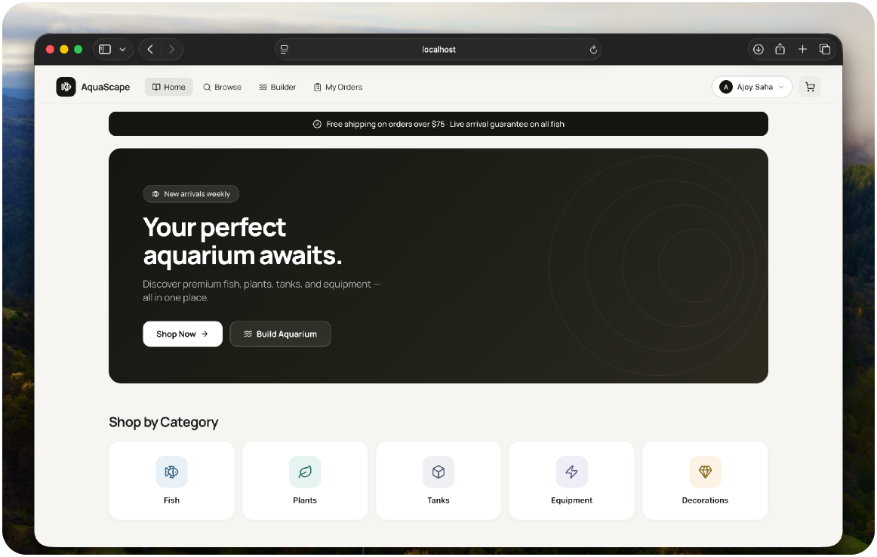
AquaScape
AquaScape is a full-stack web application built for an aquarium retail business
CSE 3110 - Database Systems Lab
by 2207037

Slide 2
Key Features

Slide 3
Technology Stack
React → Express → Oracle → Docker volume

Slide 4
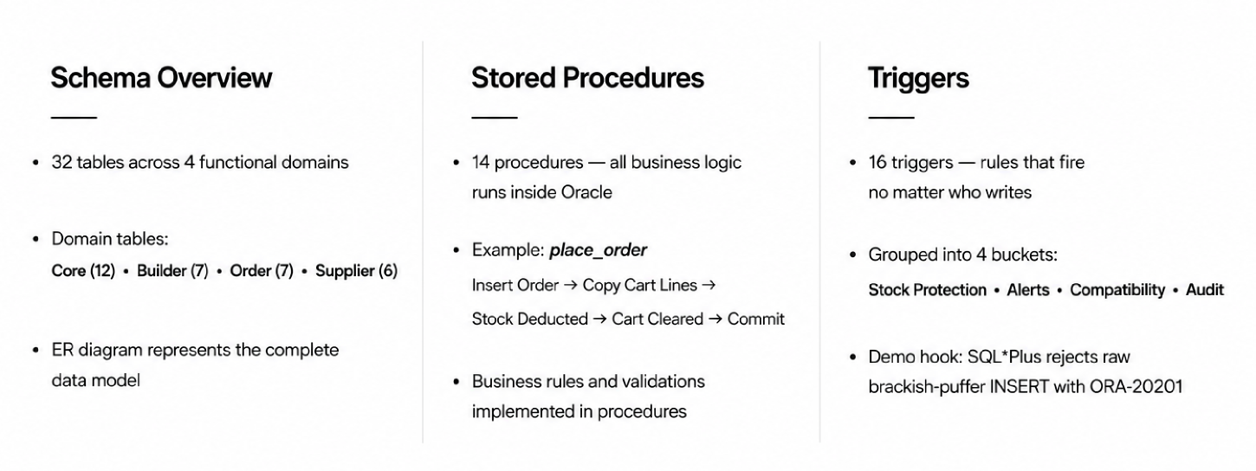
Database Architecture

Slide 5
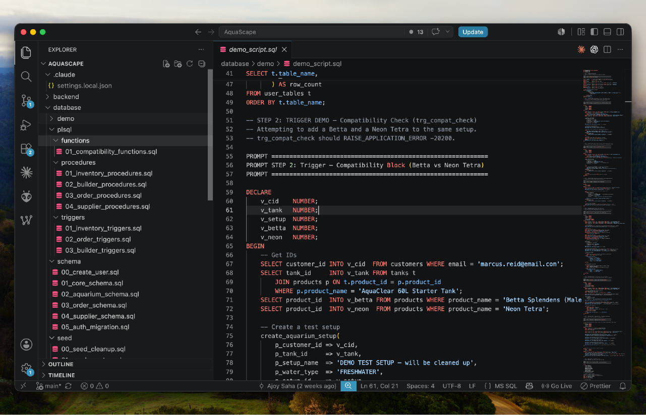
Database PL/SQL, Triggers, Schema

Slide 6
Schema Diagram

Slide 7
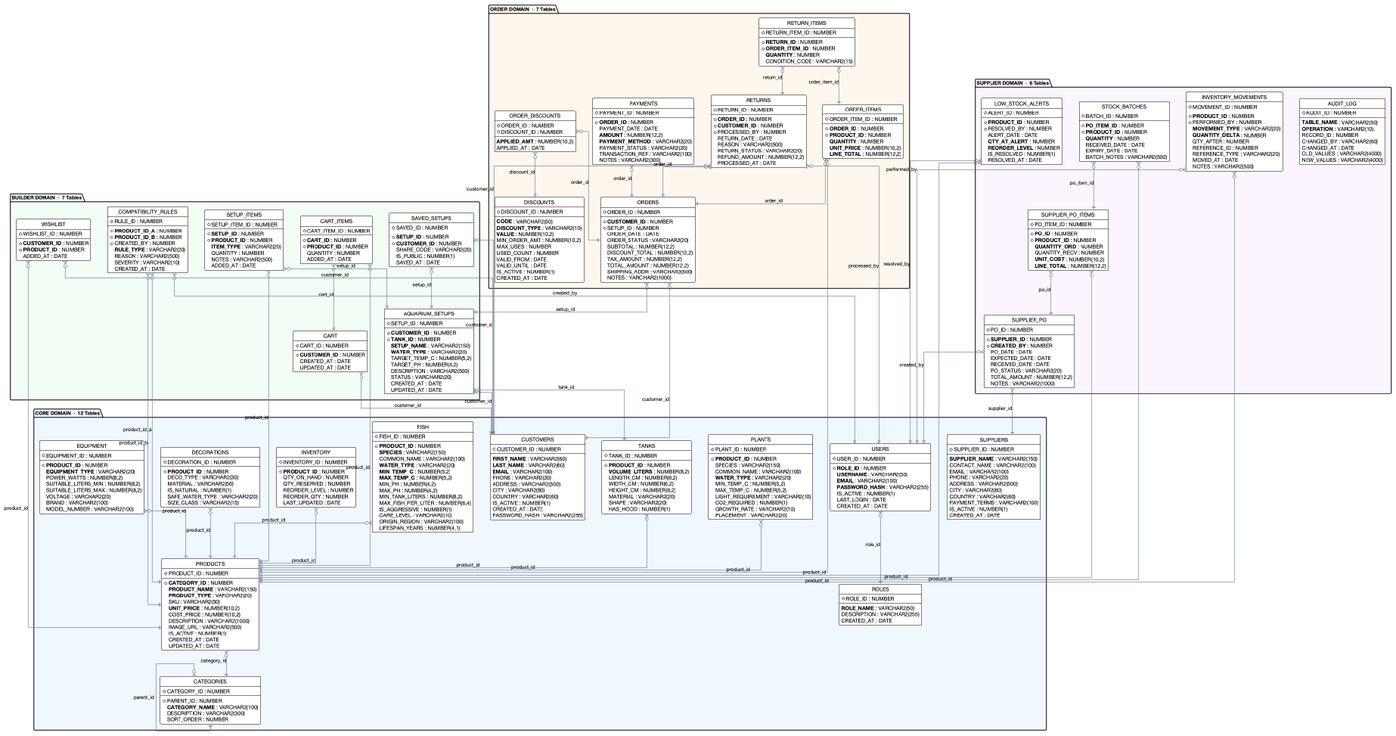

Slide 8
ER Diagram

Slide 9
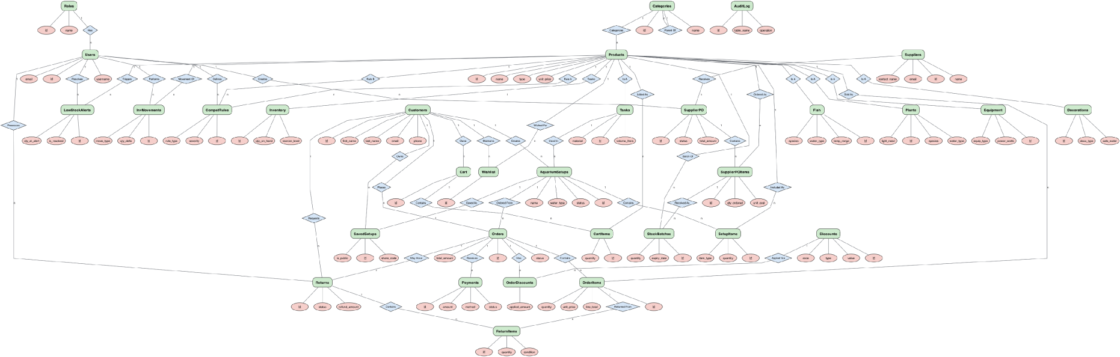

Slide 10
Project Screenshots

Slide 11
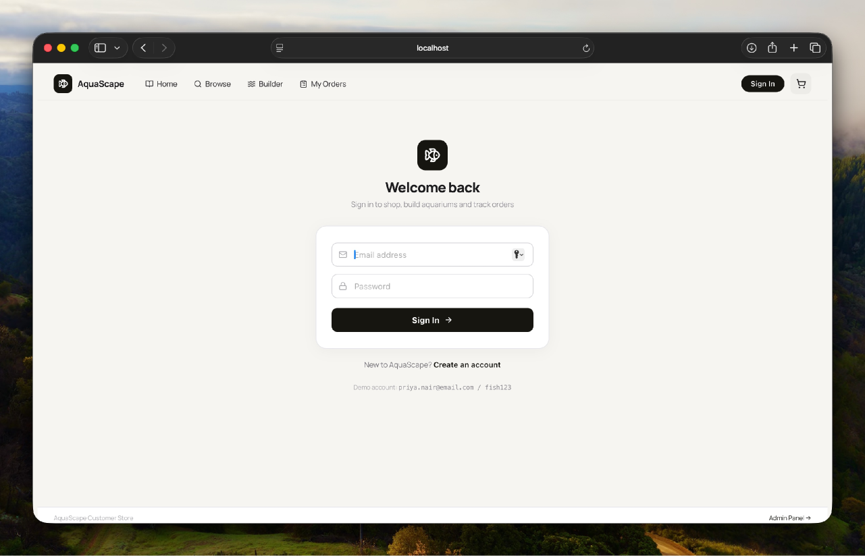

Slide 12
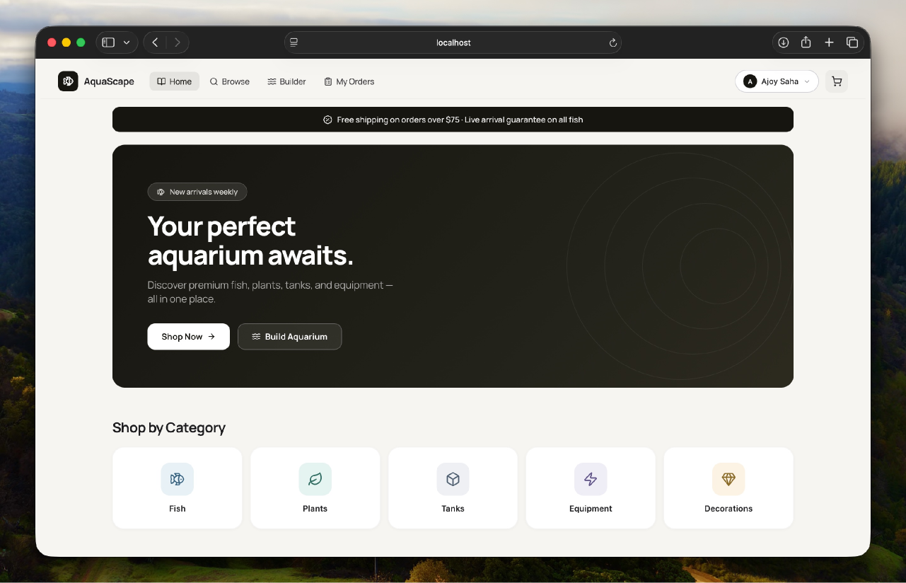

Slide 13
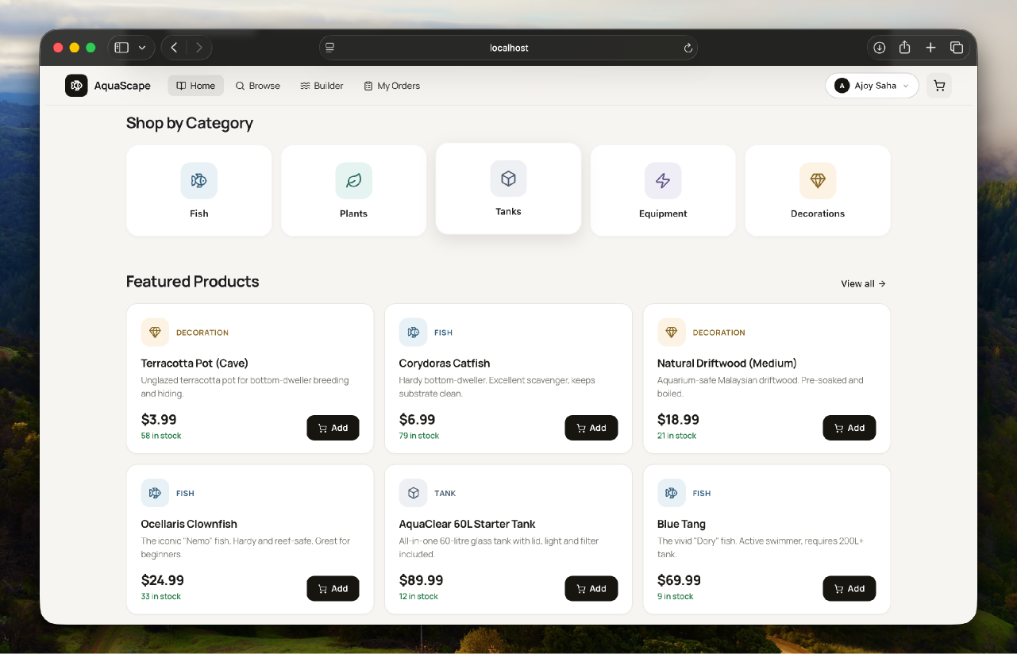

Slide 14
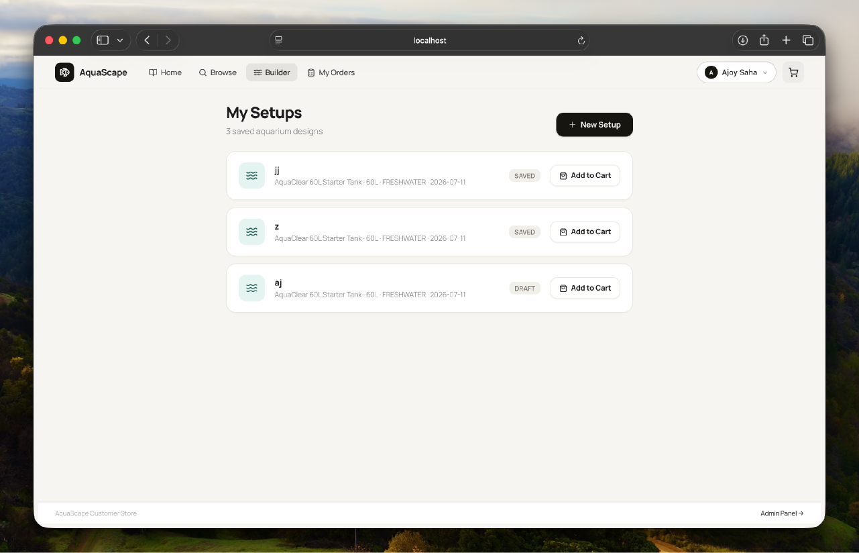

Slide 15
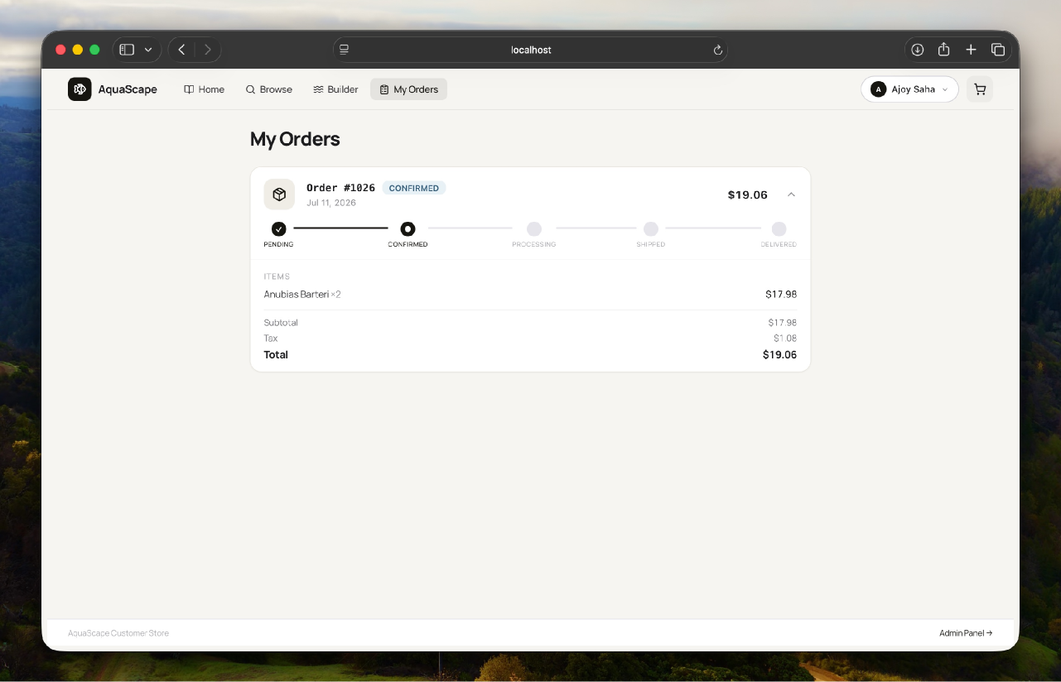

Slide 16
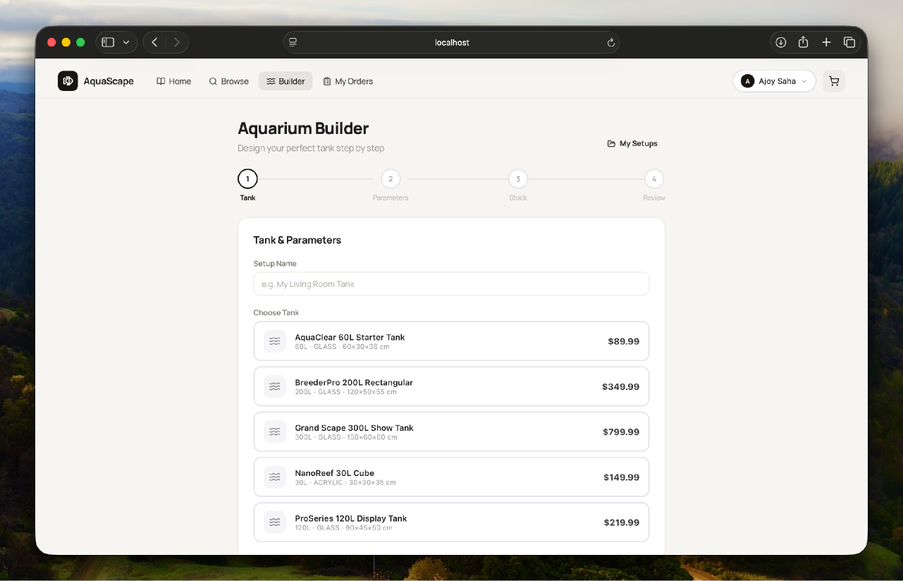

Slide 17
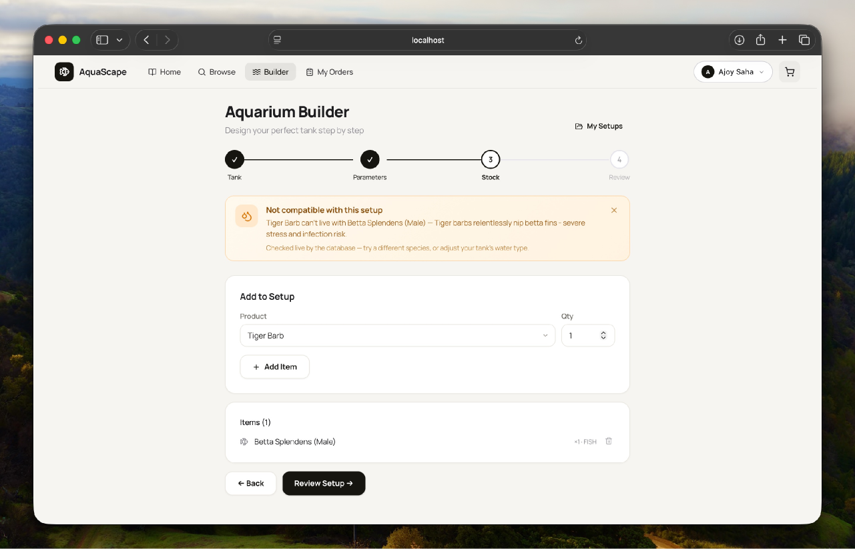

Slide 18
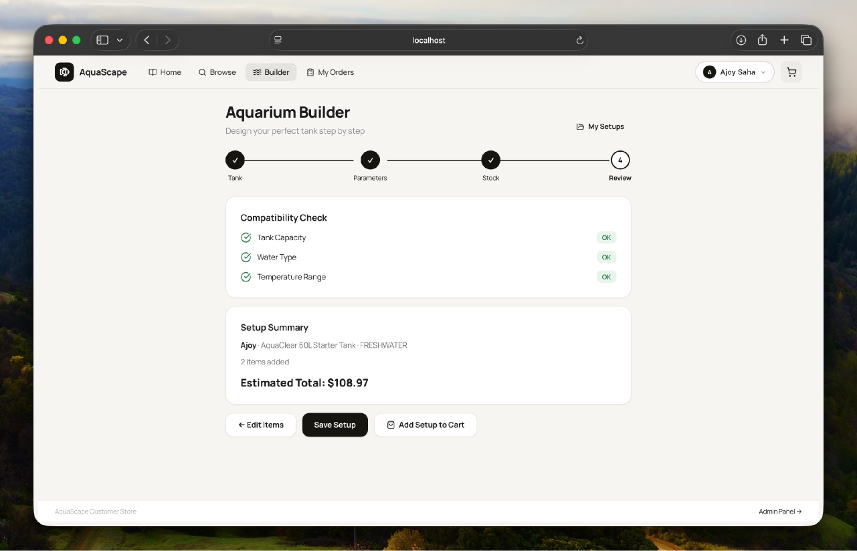

Slide 20
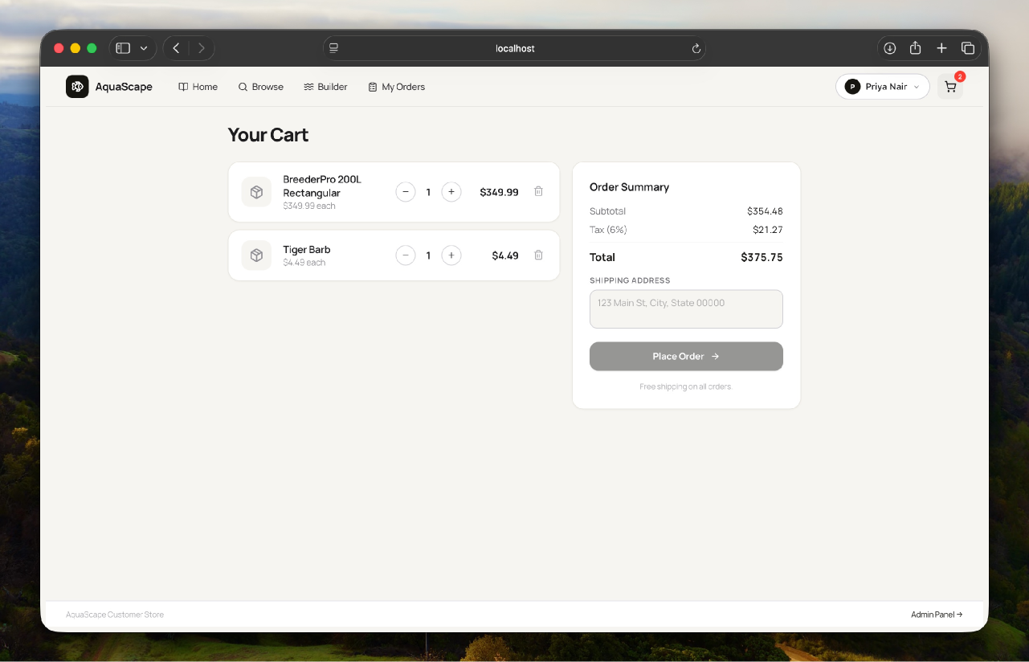

Slide 21
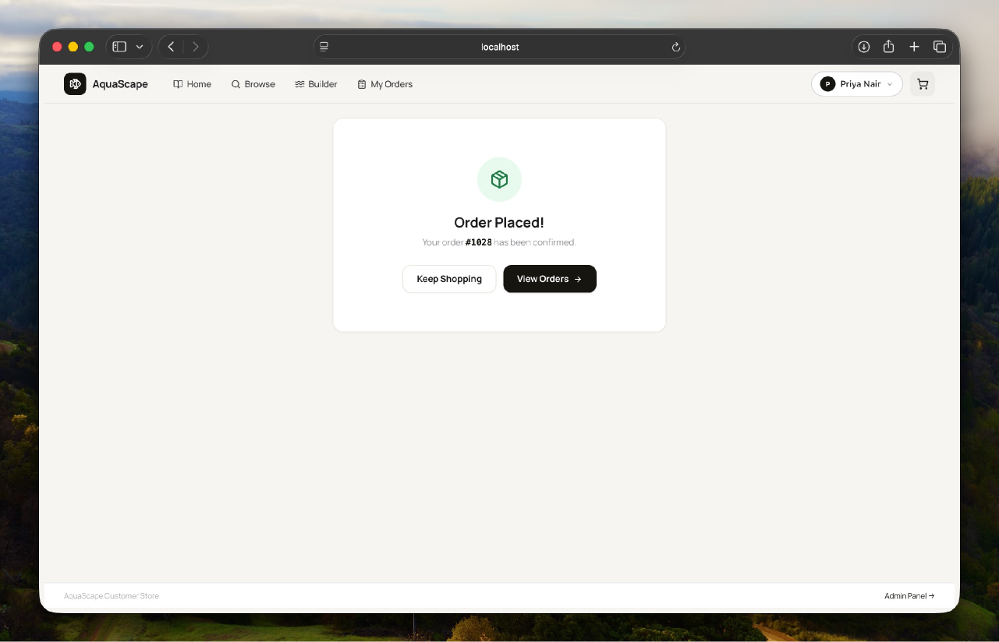

Slide 22
Github

Slide 23
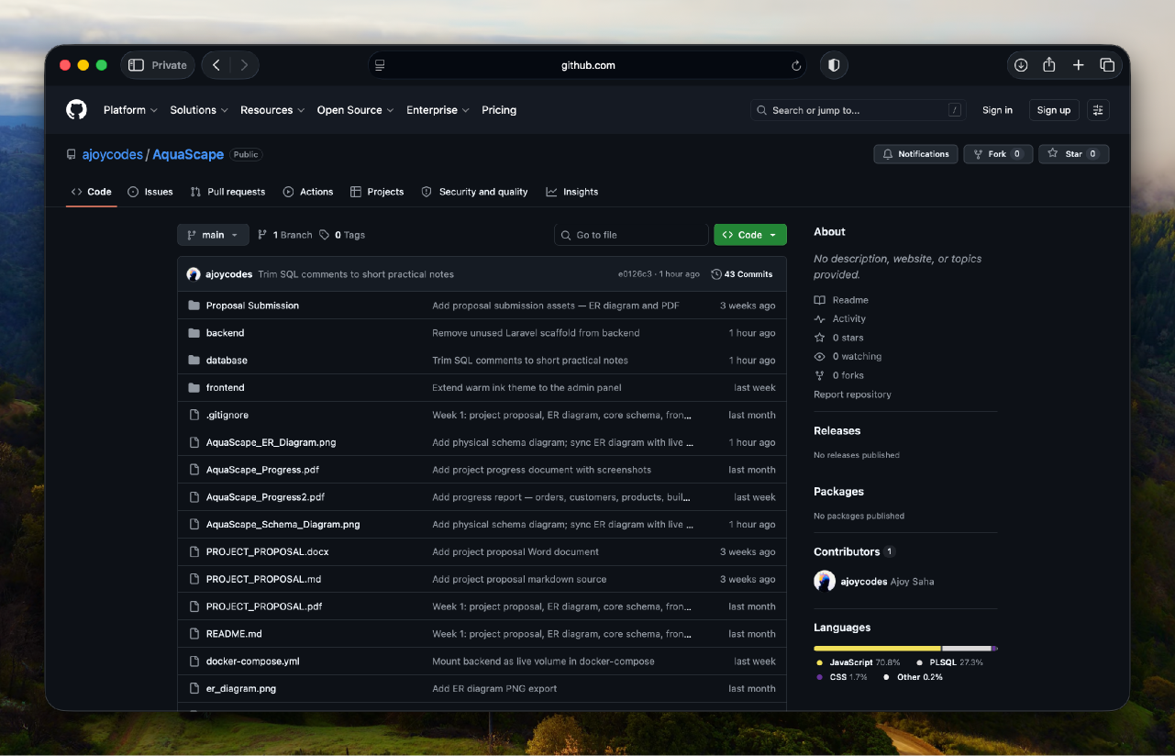
Repository

Slide 24
Thank you!

